Slide 1

Welcome!
Distance Learning: How to Read Books with Preschoolers
Presented by:
Carola Oliva-Olson, Ph.D. – California state university channel islands
Anna arambula-gonzalez, M.A. - language learning project – fresno unified school district & csuci
Hosted by:
Early edge california
Notes:
Patricia will be introduction

Slide 2












Using POLL Strategies with Storybooks Reading to Support Preschool Dual Language Learners​
Notes:
2) Thanks to Patricia Lozano for inviting us today, for her successful leadership in supporting super diverse children and families. We are very impressed and grateful for your constant support and achievements in the field of early bilingualism where there are more advantages to developing bilingual minds. She has it in her blood, always advocating for the rights of children, their families, and early childhood teachers.

Slide 3
POLL:
Personalized
Oral Language
Learning
Notes:
Carola-
3) POLL strategies and practices were developed by nationally known DLL experts, Dr. Linda Espinosa, Dr. Carola Oliva-Olson, Whit Hayslip and Elizabeth Magruder. These POLL strategies are practical and proven strategies for teaching children who are learning in more than one language.

Slide 4
Anchor Text
Vocabulary
Intentional​ Message
Songs and Chants
Enrichment Activities
Family Engagement
Notes:
Carola-
4) Here you see the components of POLL that would take a long time to describe. At the end of this seminar, we will share information so that you can read more about the method and each of the strategies that have the ultimate goal of promoting the development of the language in Spanish and English to have a solid and robust base. We know that this foundation is necessary for the academic and social future of all children. Today instead of talking about each one of those strategies, we are going to focus on sharing with you 3 suggestions to emphasize vocabulary development.

Slide 5









Our
Children
Notes:
Anna-
These hearts are like our children, they are all different, none is the same. Children are very diverse including the languages ​​they speak in their families and cultural practices and interests. Today, our families more than ever need emotional support to promote health and wellness. The virus crisis has caused much anxiety, concern and stress in children, their families and educators. Many of you are currently caring for the children of essential workers, or others of you are at home trying to find effective and entertaining ways to connect with your children through the internet. Today we are going to present 3 suggestions to teach new vocabulary and at the same time support the emotional health of children, families, ourselves.

Slide 6
Recommendation #1: increase emotional vocabulary
Notes:
Anna-
One way to start supporting children in this situation is by teaching vocabulary to express feelings and emotions. It is important not to stick with basic words but to continually expand vocabulary with new, complex and even sophisticated words.

Slide 7

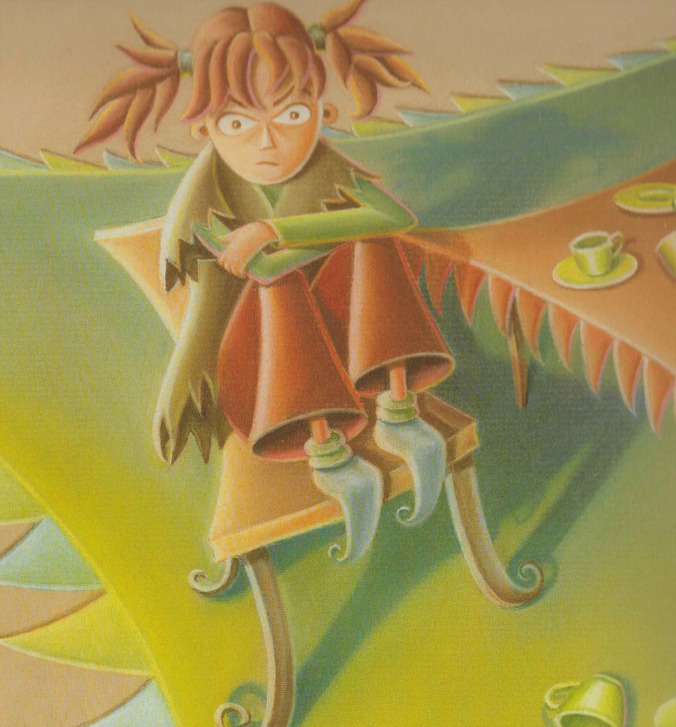
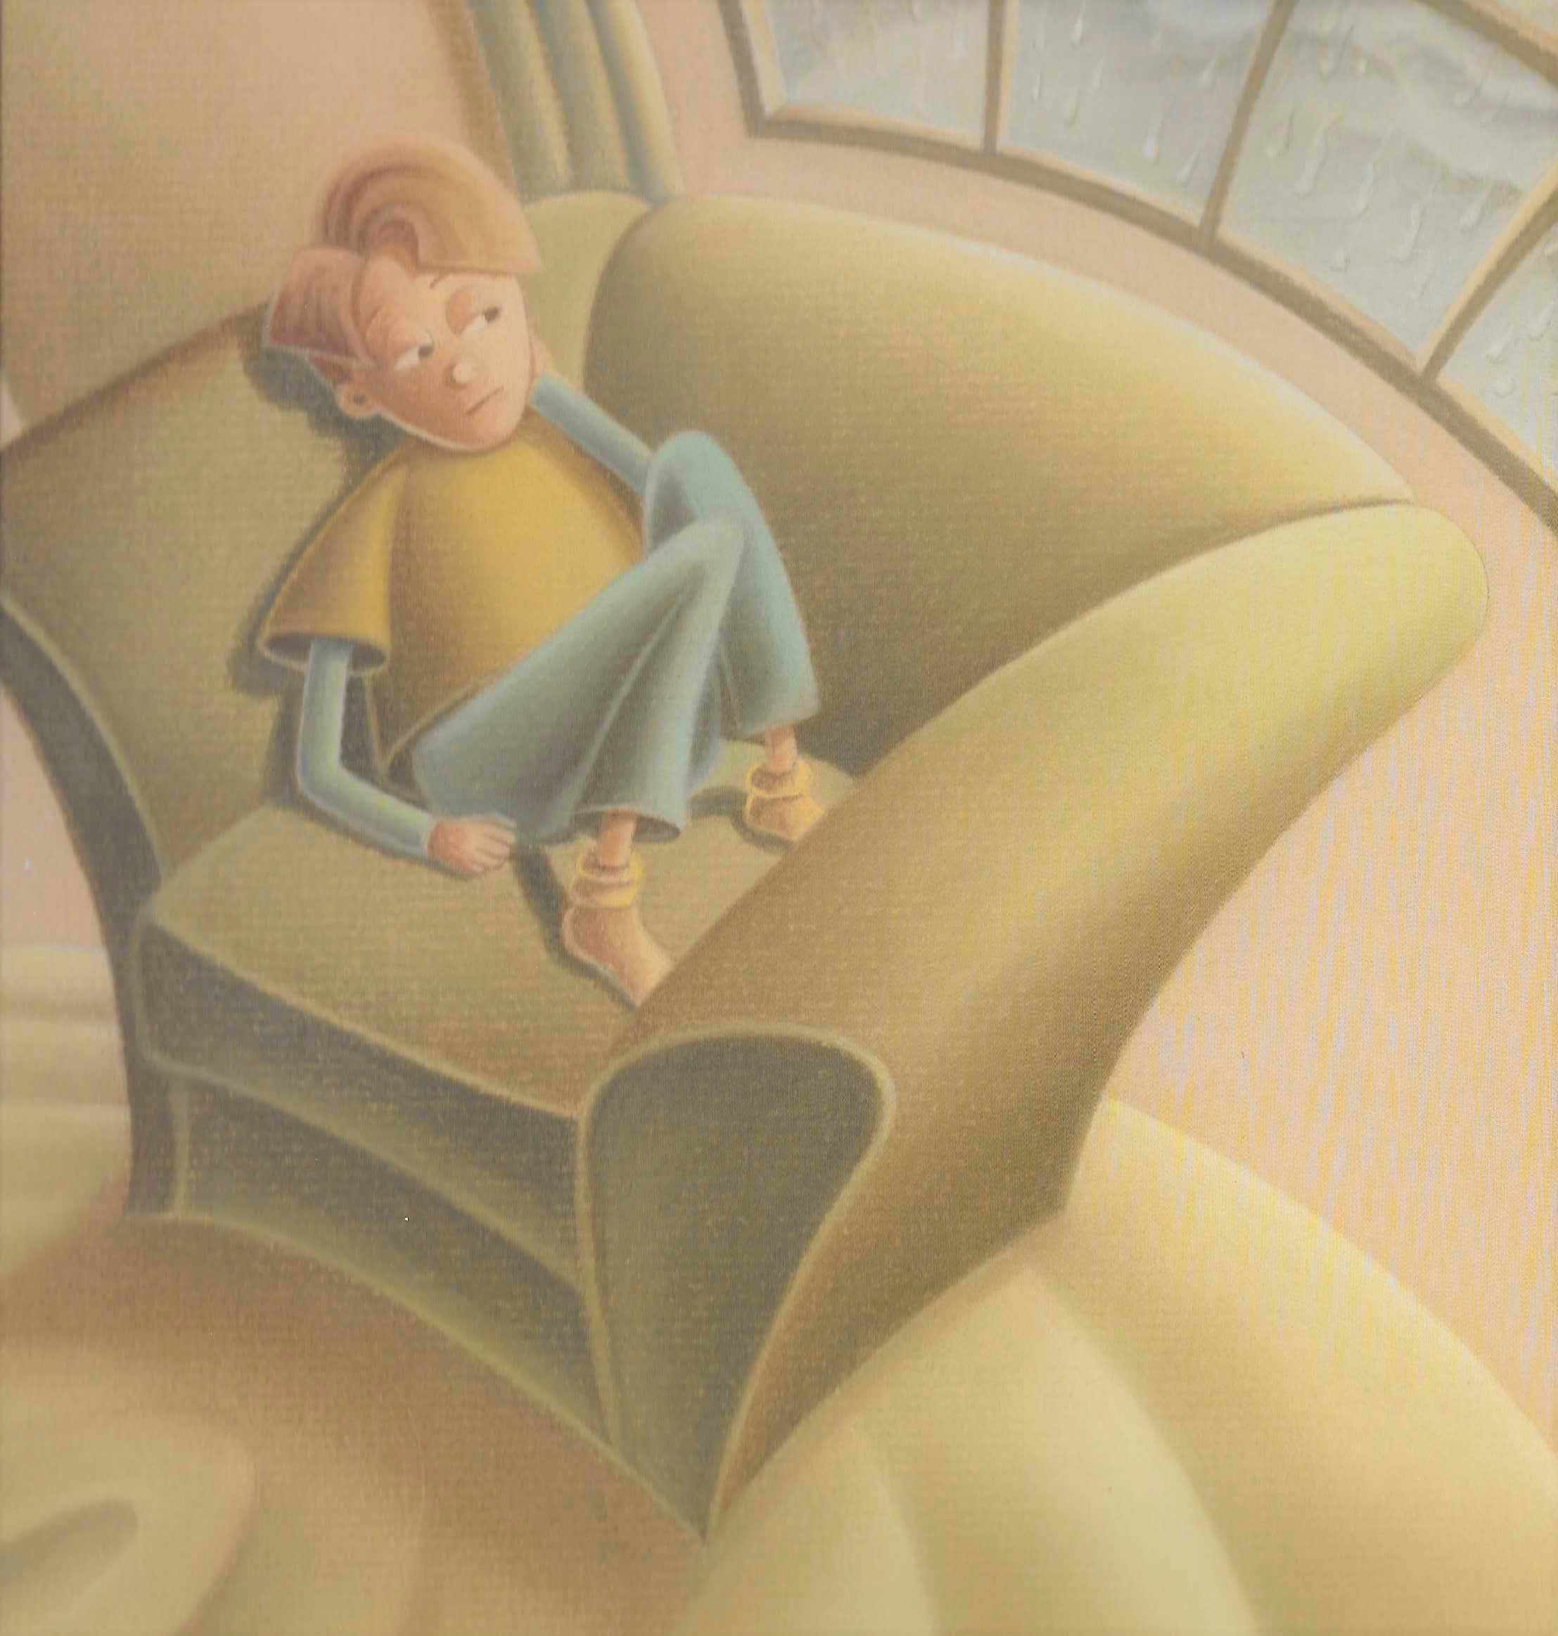
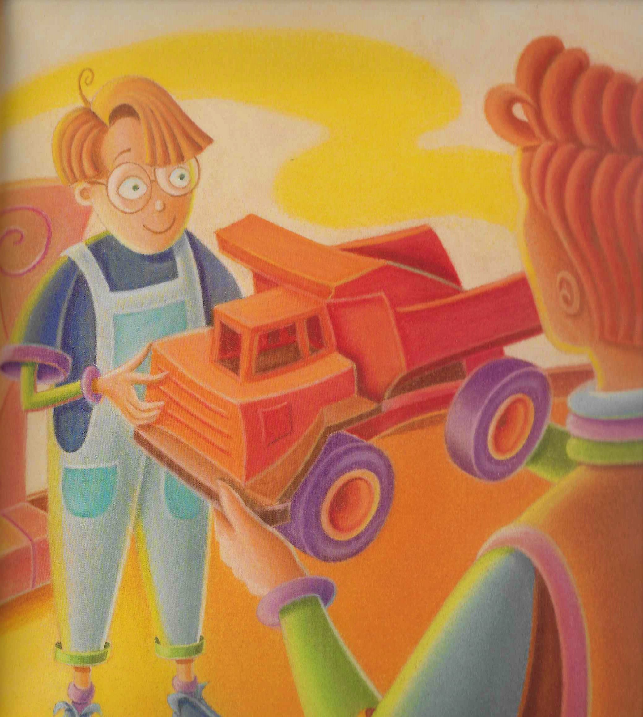
How do you feel today?
Disillusioned
Bored
Grateful
Notes:
Anna-
: Show the screen while introducing the book and vocabulary (1 minute), then the camera can focus on Anna while reading the books for about 10 minutes)
When connecting with your children, you can use books that deal with feelings and emotions like this story called "This is how I feel." This book is available in English too. We can highlight that we all have emotions and feelings and that these can change quickly. It is not always necessary to read the full story, but to choose previously which pages you want to show and read. This story focuses on some emotions of a girl and I have chosen some pages to show you. In this story I decided to focus on the feeling of being "Disillusioned or Disillusioned imagine you would wonder if it is not too complex a word. But being a very long word, that makes it even more interesting "" Disillusioned or Disillusioned. Let us remember that preschool children need to hear and use many new, complex and sophisticated words. When we introduce a new word we always give a definition and an example.
Let us remember that preschool children need to hear and use many new, complex and sophisticated words. When we introduce a new word we always give a definition and an example. In this case you could say to the children, Being disappointed means, or means that you wanted something and suddenly it could not happen.
For example, I was disappointed when my sister was unable to attend my birthday dinner at the last minute.
Anna: Carola, how are you feeling today?
Carola: I feel very disappointed that I can't go to school today
Grateful: Feeling Grateful is when you give thanks for something that someone does for you.
Anna: For example, I am grateful to my husband because he made dinner yesterday while I worked. Carola, how grateful are you today?
Carola: Today I feel very grateful because my daughter is learning to read and write in Spanish
Another word to expand vocabulary is
Bored or bored: There are probably many who already know this word but do not use it frequently. The purpose is to learn new words and use them often. Always starting to define, explain what it means. For example, feeling bored or bored is when you are not doing anything or when someone asks us to do something that we do not like because it is very boring. For example, sometimes my son tells me, "Mom, I have nothing to do, I'm bored. "I say to him, "You can help me with dinner if you are bored" and he replies, "That is also very boring too, I want to go out and play with my friends.

Slide 8
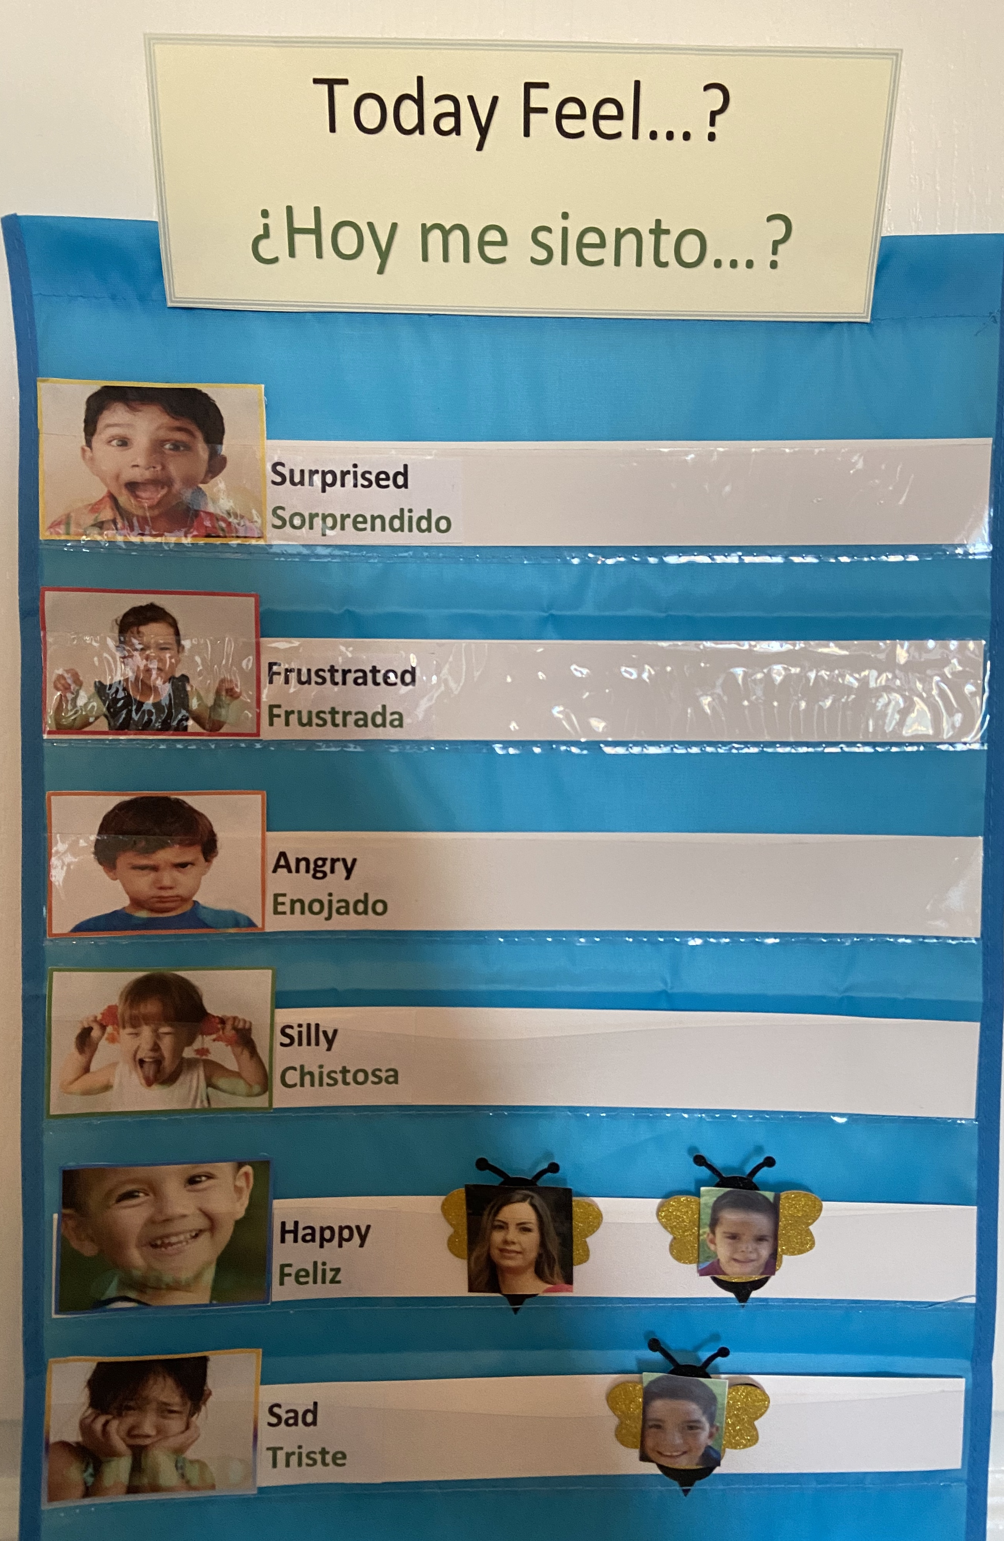
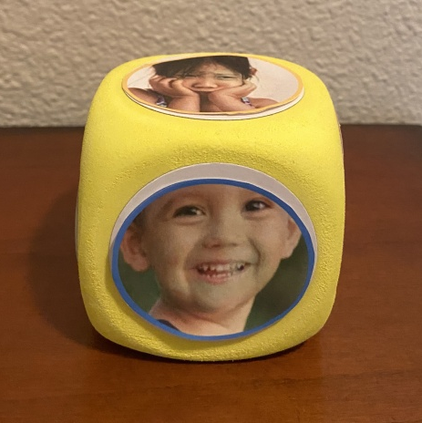
Notes:
Anna-
Some of you are still providing services with families at home, others of you are meeting with children via zoom and/or other methods, the check in is something that you can still do from home if you have pictures of the children saved on your electronic device and if you don't simply asking children verbally is also a great way to check in with them.
The idea of the emotional cube that is something that parents can do at home and ask their child how they feel when they wake up.

Slide 9
Timid
thankful
worried
enthusiastic
Notes:
Importance of going beyond common emotions, better known to give children new vocabulary that reflects what they are experiencing and share with their families and encourage dialogue using this new vocabulary

Slide 10
Recommendation #2: teach and use gestures
Notes:
Carola:
Some of you are working with children at home, or virtually using zoom or face time. Very interesting! gestures help us communicate better.

Slide 11

New words
lost
worried
Notes:
Carola:
¡Muy interesante!
los gestos nos ayudan a comunicarnos mejor.

Slide 12
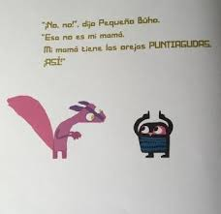
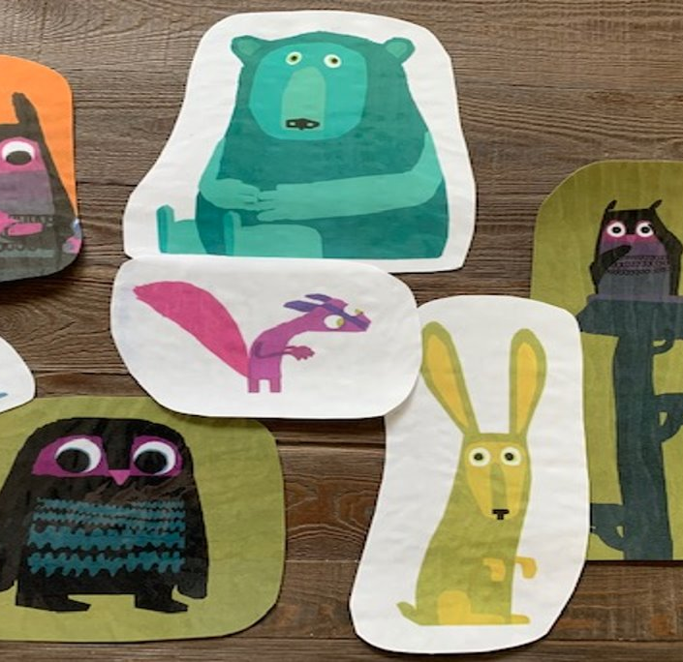
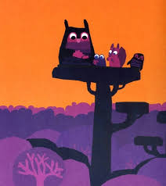
Gestures
Notes:
Carola
Row row your boat tune

Slide 13
Recommendation #3: foster wonder and curiosity
Notes:
Carola

Slide 14


Joyful,
Inspiring, and
Positive Stories
Notes:
Carola:
El mensaje intencional se muestra para que los adultos puedan resaltarlo cuando sea necesario durante el día.
Comunicado verbalmente durante las comidas, uno a uno, exploración exterior / interior.
Podría ser el mismo mensaje para una semana, dos semanas la maestra determina cuándo deberían cambiarlo.
Dependiendo de las edades de los niños, una palabra de vocabulario puede estar presente en el mensaje intencional.
La palabra del vocabulario se resalta o subraya para que los educadores sepan qué concepto se está enseñando.

Slide 15

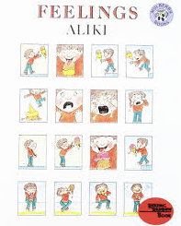
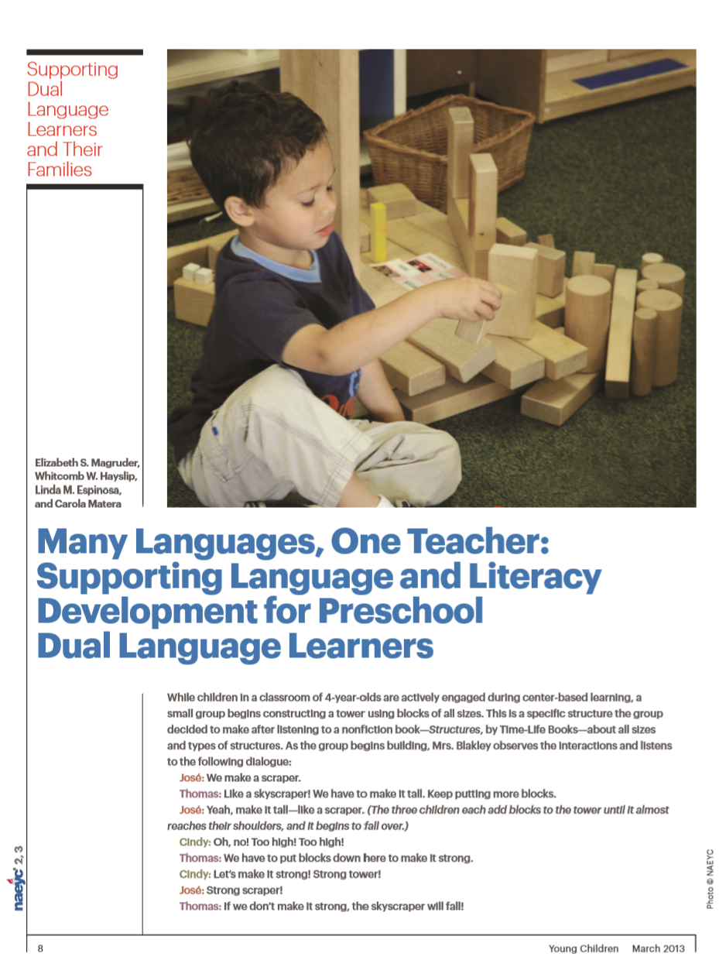
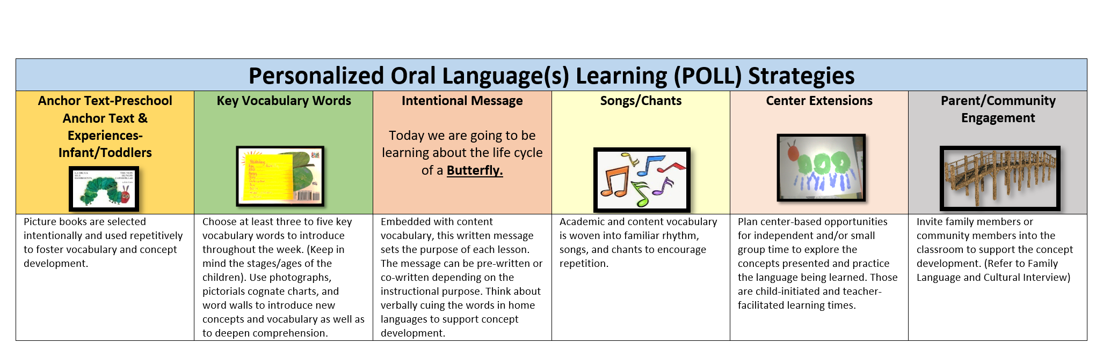
RESOURCES
Notes:
These are resources that we are going to share with you after this webinar and you can use them in your programs.

Slide 16
Questions?
Notes:
Patricia

Slide 17

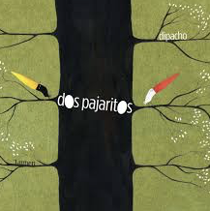






Next Webinar
Notes:
Carola

Slide 18
Notes:
Anna and Carola

